Slide 1

Machine Learning for Engineers: Evaluation Metrics in Regression Models
Mina Farmanbar
Associate Professor, University of Stavanger
for engineers

Slide 2
Regression Accuracy
Evaluation metrics are used to explain the performance of a model.
Evaluation metrics provide a key role in the development of a model as it provides insight to areas that require improvement.

Slide 3
Model Evaluation Metrics
Mean Absolute Error
Mean Squared Error
Root Mean Squared Error
but before we get into defining these, we need to define what an error actually is…

Slide 4
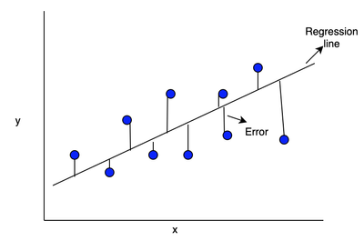
Error of the Model
In the context of regression, the error of the model is the difference between the data points and the trend line generated by the algorithm.
Predicted Value
Error: measure of how far the data is from the fitted regression line
Actual Value

Slide 5
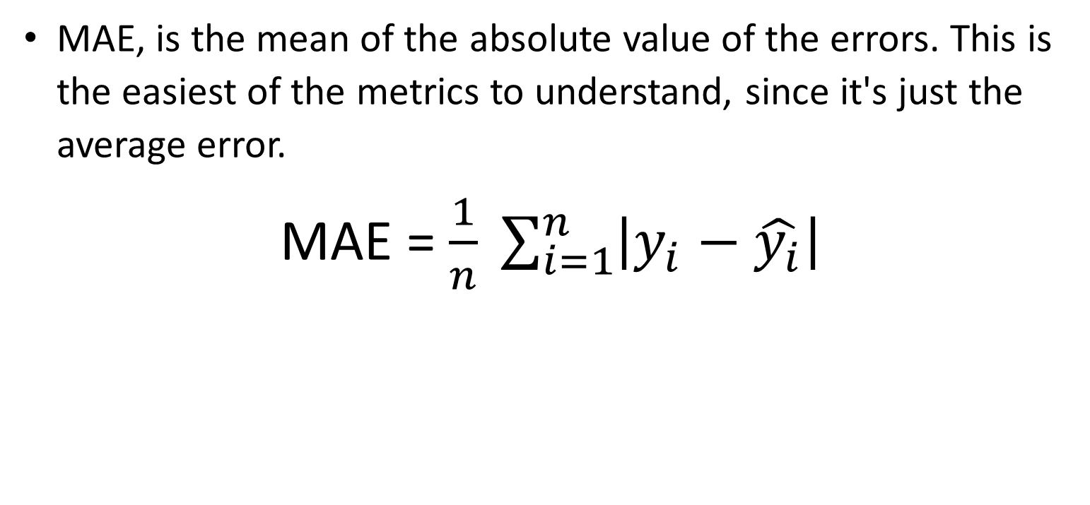
Mean Absolute Error (MAE)
MAE, is the mean of the absolute value of the errors. This is the easiest of the metrics to understand, since it's just the average error.
MAE = $\frac{1}{n} \sum_{i=1}^{n}{\left|y_{i}−\hat{y_{i}}\right|}$

Slide 6
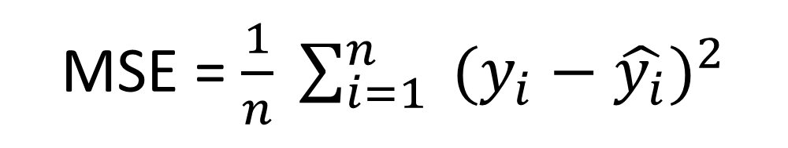
Mean Squared Error (MSE)
MSE, is the mean of the squared error. It's more popular than Mean Absolute Error because the focus is geared more towards large errors making it more sensitive to outliers.
MSE = $\frac{1}{n} \sum_{i=1}^{n}{ {(y_{i}−\hat{y_{i}})}^{2}}$

Slide 7
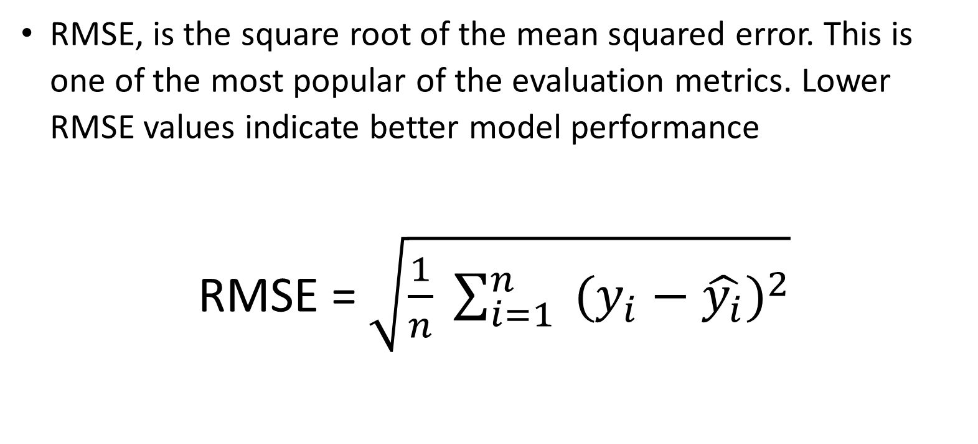
Root Mean Squared Error (RMSE)
RMSE, is the square root of the mean squared error. This is one of the most popular of the evaluation metrics. Lower RMSE values indicate better model performance
RMSE = $\sqrt{\frac{1}{n} \sum_{i=1}^{n}{ {(y_{i}−\hat{y_{i}})}^{2}}}$

Slide 8
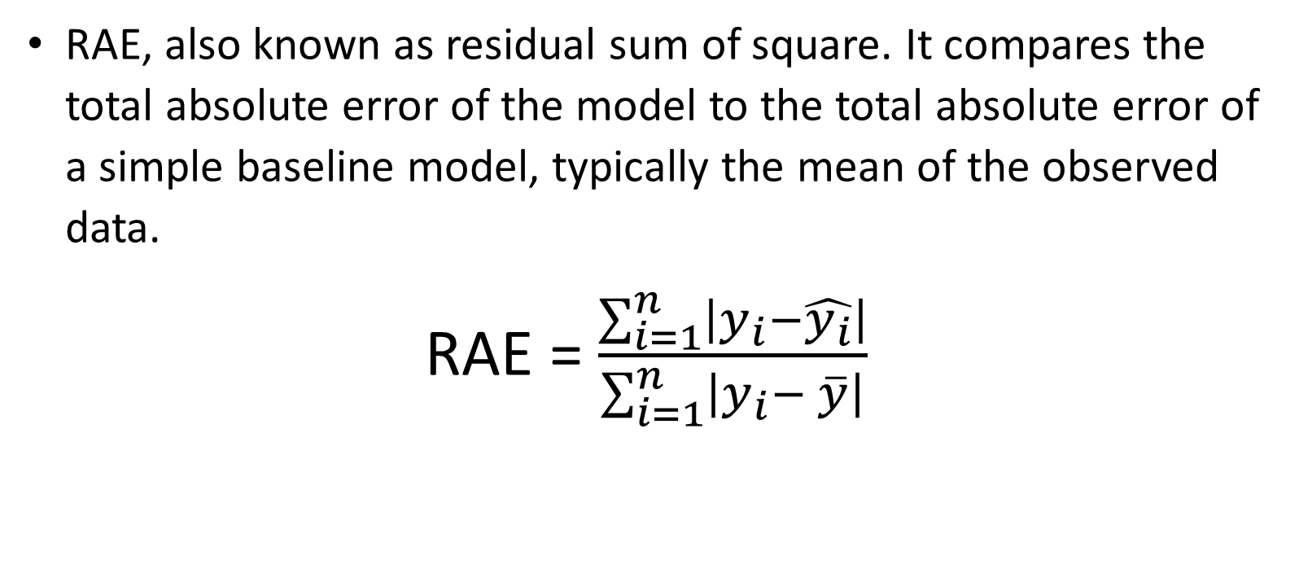
Relative Absolute Error (RAE)
RAE, also known as residual sum of square. It compares the total absolute error of the model to the total absolute error of a simple baseline model, typically the mean of the observed data.
RAE = $\frac{\sum_{i=1}^{n}{\left|y_{i}−\hat{y_{i}}\right|}}{\sum_{i=1}^{n}{\left|y_{i}− \overline{y}\right|}}$

Slide 9
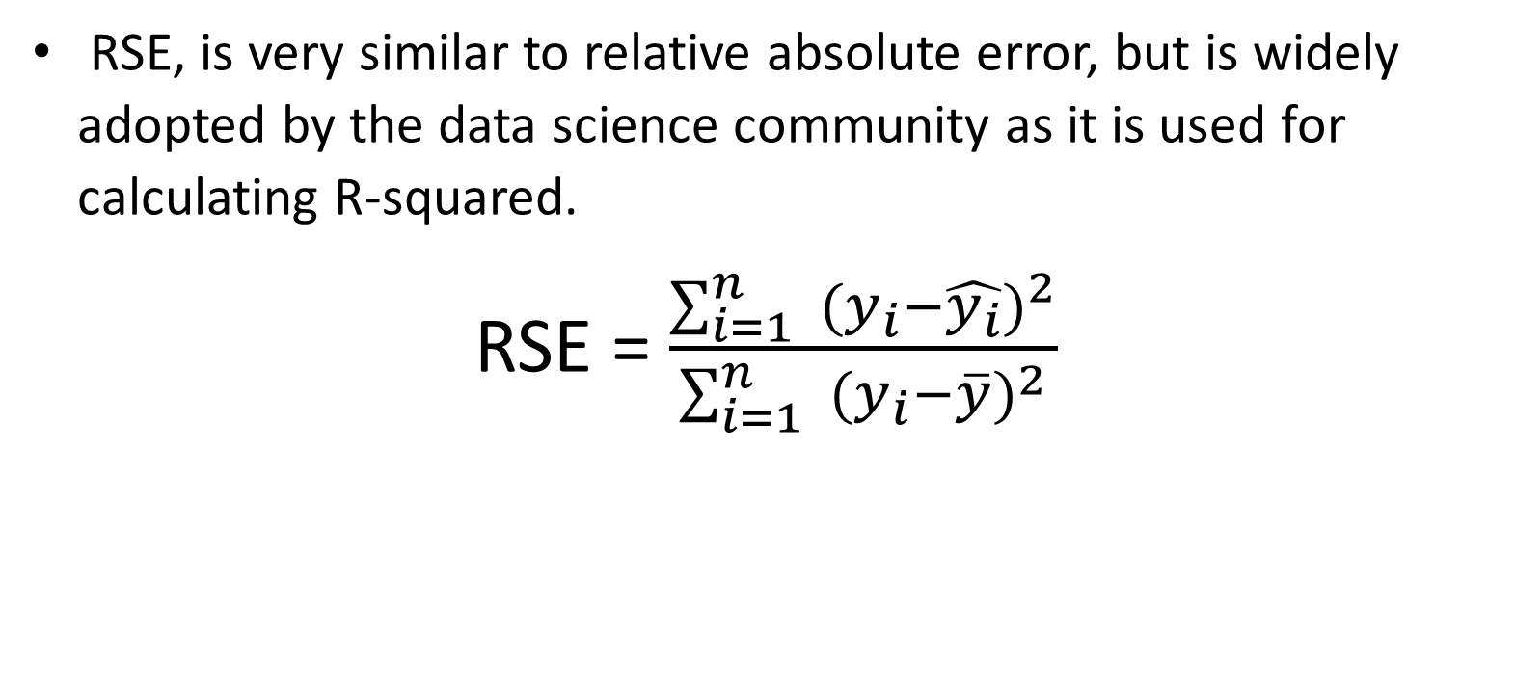
Relative Squared Error (RSE)
RSE, is very similar to relative absolute error, but is widely adopted by the data science community as it is used for calculating R-squared.
RSE = $\frac{\sum_{i=1}^{n}{ {(y_{i}−\hat{y_{i}})}^{2}}}{\sum_{i=1}^{n}{ {(y_{i}−\overline{y})}^{2}}}$

Slide 10
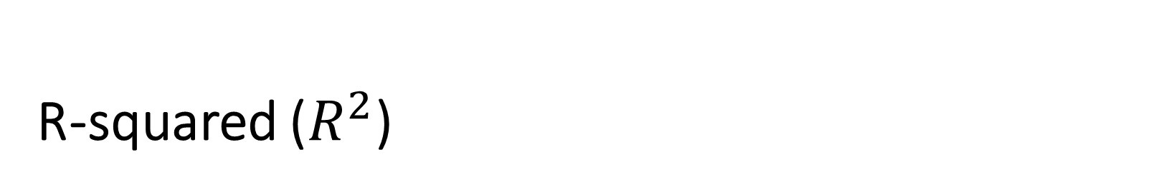
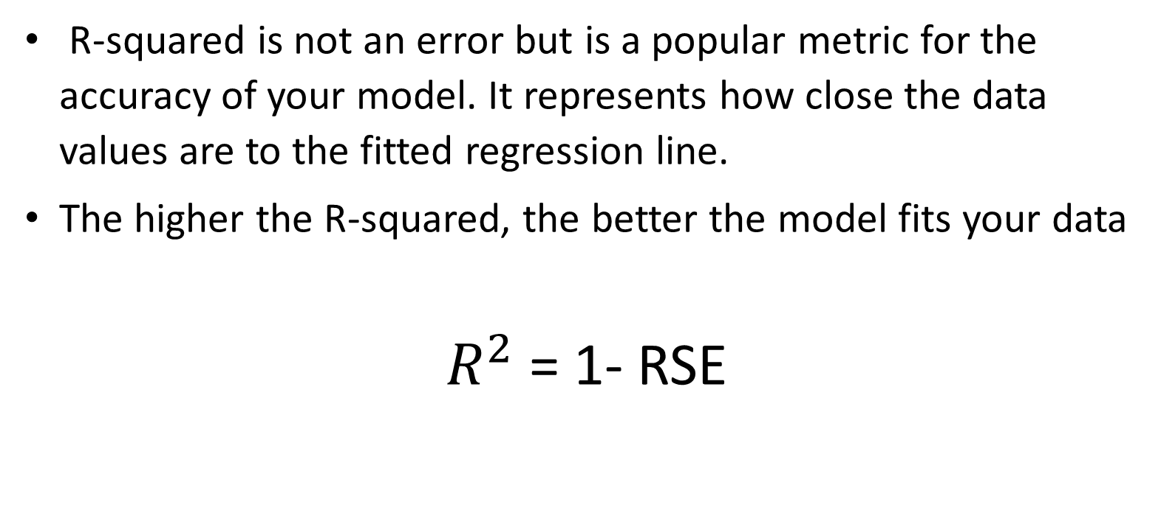
R-squared ($R^{2}$)
R-squared is not an error but is a popular metric for the accuracy of your model. It represents how close the data values are to the fitted regression line.
The higher the R-squared, the better the model fits your data
$R^{2}$ = 1- RSE

Slide 11
Summary
Each of these metrics can be used for quantifying of your prediction.
The choice of metric completely depends on the type of model your data type and domain of knowledge.

Slide 12
Thank you
Mina Farmanbar
mina.farmanbar@uis.no

